Slide 1
End-End Client Testing Solution
Jorge Ramirez, Omar Elhefnawy, Nada Elhaddad
School of Computing and Communications
Lancaster University Leipzig, Germany
j.ramirez1@lancaster.ac.uk | o.abdelazizelhefnawy@lancaster.ac.uk| n.elhaddad@lancaster.ac.uk

Slide 2
Roles in the Project
Student Name | Requirements | Design | Implementation | Testing
Jorge Ramirez | X | X | X | X
Omar Elhefnawy |  |  | X | X
Nada Elhaddad | X |  | X | X

Slide 3
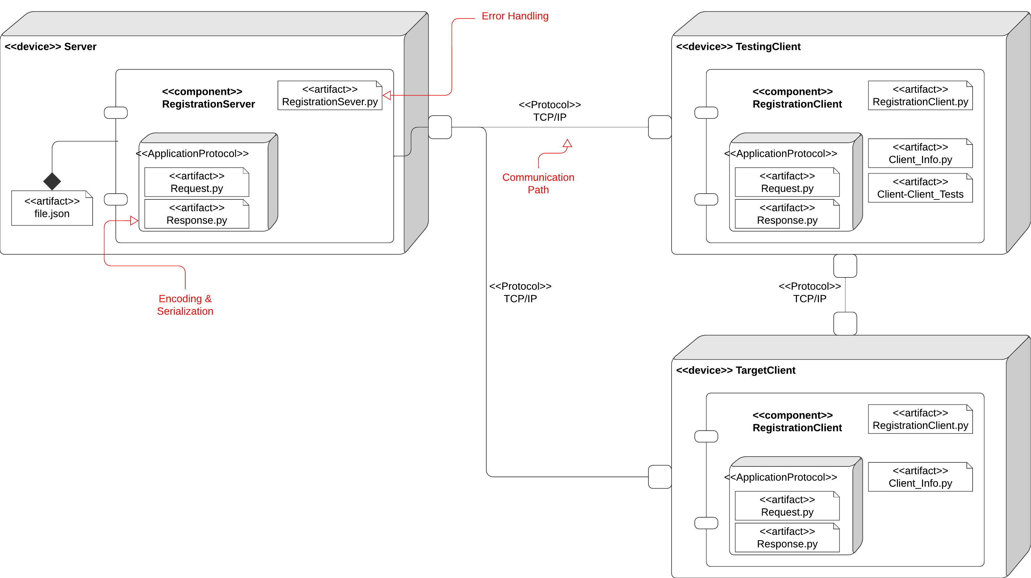
Network System Architecture
Notes:
Utilized Network Concepts:
Application Protocol
TCP Communication Path
Error Handling

Slide 4
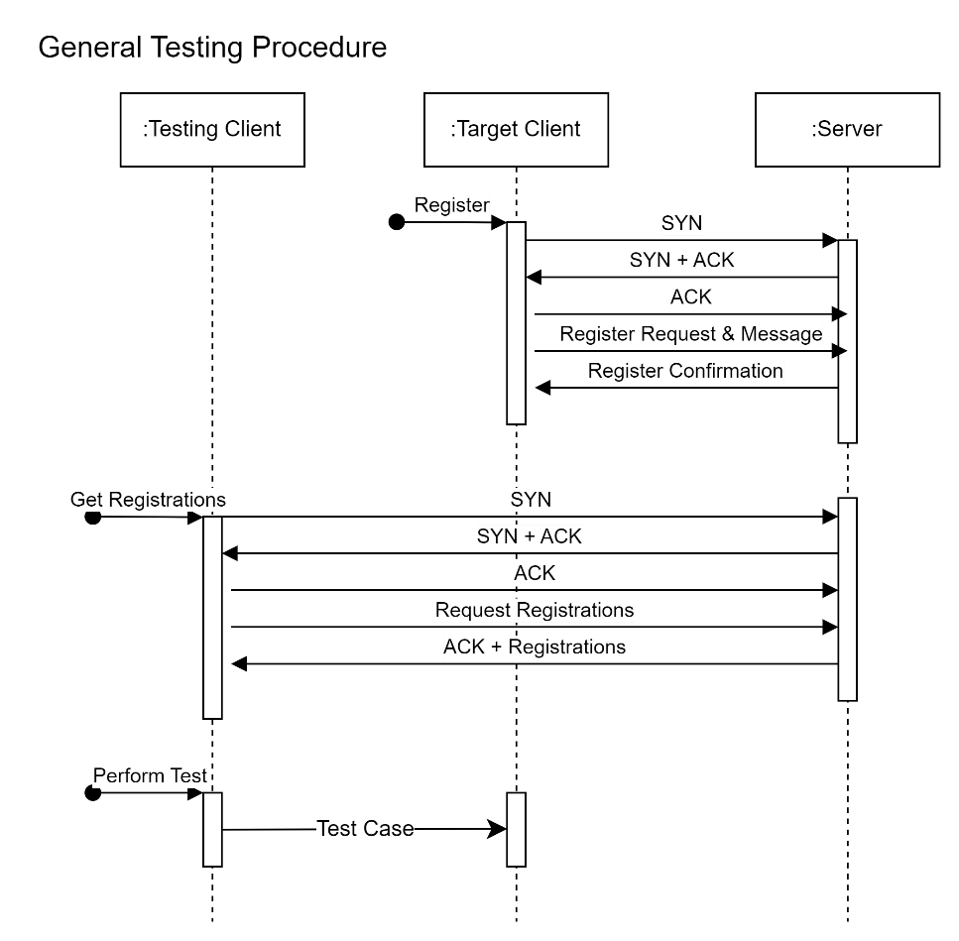
System Demonstration
Application Protocol Demonstration
Request & RequestTypes
Response & ResponseTypes
Server Demonstration
Server-Client Handling via TCP
Error Handling via ResponseTypes
Client-Client Tests Demonstration
Tests to be performed
Sample Test-case showcase
Client Demonstration
General Testing Procedure Showcase

Slide 5
System Testcases
Server Unit Test
Test Cases Unit Test
Client Unit Test
Client-Server Integration Test

